Slide 1
FITNESS
ACTIVITY
RECOGNITION
Third Week: 31 July to 6 August

Slide 2
Agenda
Dataset
DTW
Goals for next week

Slide 3
Dataset :
Internet Resources:
Fitness progress videos
Do and don’t Videos
Libraries:
MPII
COCO
HumanEva
Human3.6M
SURREAL (Synthetic hUmans foR REAL tasks)

Slide 4

DTW: Test Videos
Used 3 different videos for preliminary comparison:
Video 1: Trainer Video
Video 2: Trainee Video with correct form
Video 3: Trainee Video with wrong form

Slide 5
DTW: Algorithm
Extracted coordinates of 33 keypoints using Mediapipe Blazepose
Preprocess it and used the dtaidistance library using the dtw_ndim.distance method
In total 2 algorithms implemented to compare 2 videos (initial code can be found here)
Algorithm 1.1: Compare 33 key-points individually: Compare (n,3) dimensional vectors and compute the average score (n: # of frames)
Algorithm 1.2: Compare 25 relevant key-points individually: Same as above, but we only consider the key-points corresponding to the upper-body, which is relevant for bicep curls
Algorithm 2.1: Compare (n, (33,3)) dimensional vectors directly
Algorithm 2.2: Compare (n, (25,3)) dimensional vectors directly (only relevant upper-body key-points)
Note: We compare the arrays after normalizing them

Slide 6
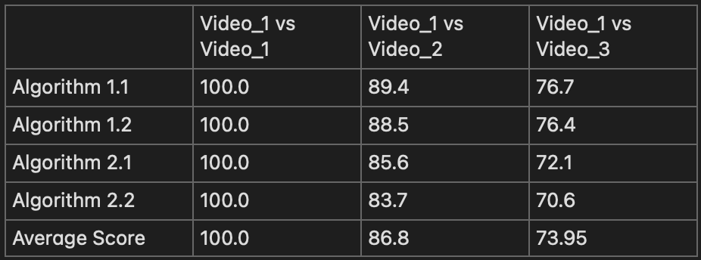
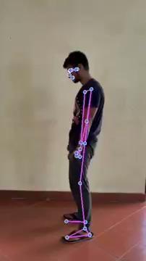
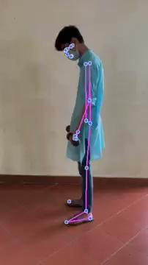
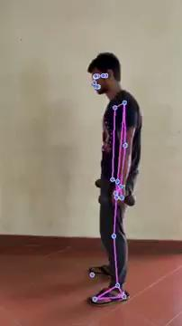
DTW: Algorithm Results

Slide 7
DTW: Challenges
These algorithms seem to fail when orientation of the person in the videos we are comparing with is different (say left facing or right facing)
Possible Solutions:
Use multiple trainer videos in different orientations and consider the best of many scores
We can also construct mirror videos of trainee and compare them with the trainer video and consider the best of original and mirror score
We can consider some other algorithms: Pr-VIPE?
We can also consider relevant joint angles (requires domain expertise)
This can be quite slow for larger videos,: will try the faster C version for better performance

Slide 8
Goals for next week
Obtain concrete implementation of Pr-VIPE
Obtain more knowledge about Deep Sort
Obtain more datas for testing
Try out and implement new and hopefully better algorithms
Try testing these on broader classes of videos
Try optimising DTW, try out the C version for faster runtime

Slide 9
THANK YOU

